Slide 1
American Board of Nursing Specialties Member Organization Profiles
Wednesday, February 20, 2019

Slide 2
24
Total Responses
Complete Responses: 17

Slide 3
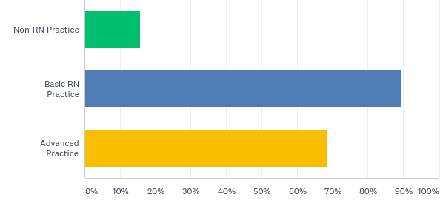
Q3: Which of the following certification credentials does your organization offer? Please select all that apply.
Answered: 19 Skipped: 5

Slide 4
Q3: Which of the following certification credentials does your organization offer? Please select all that apply.
Answered: 19 Skipped: 5

Slide 5
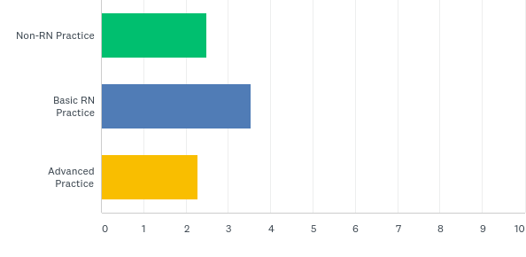
Q5: How many different certification credentials does your organization offer (by certification type)?
Comparison of Certificants by Type of Certification
* 16,771 inter-professional subspecialty certificants; 72,159 technicians or non-licensed personnel.
Answered: 17 Skipped: 7

Slide 6
Q5: How many different certification credentials does your organization offer (by certification type)?
Answered: 17 Skipped: 7

Slide 7
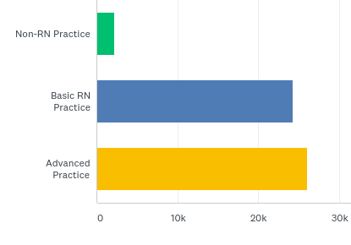
Q6: How many active certificants do you have (by type)?
Answered: 17 Skipped: 7

Slide 8
Q6: How many active certificants do you have (by type)?
Answered: 17 Skipped: 7

Slide 9
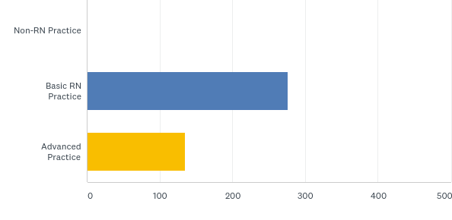
Q7: How many retired certificants do you have (by type)?
Answered: 15 Skipped: 9

Slide 10
Q7: How many retired certificants do you have (by type)?
Answered: 15 Skipped: 9

Slide 11
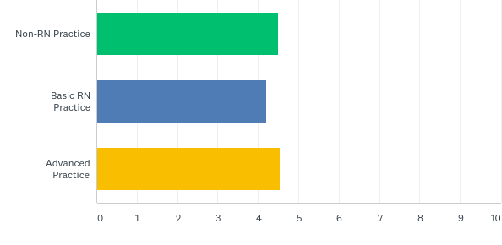
Q8: How long is certification granted to certificants? Please enter in years.
Answered: 17 Skipped: 7

Slide 12
Q8: How long is certification granted to certificants? Please enter in years.
Answered: 17 Skipped: 7

Slide 13
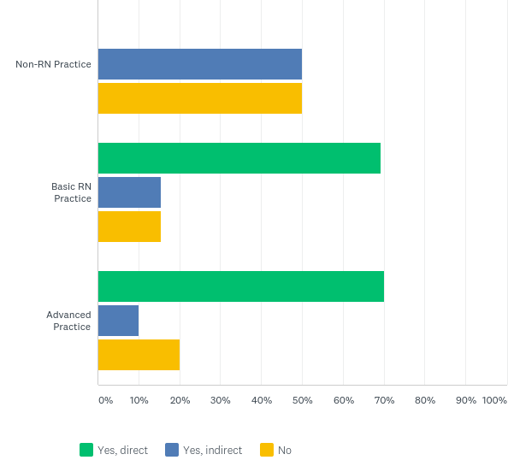
Q9: Is direct or indirect clinical experience required for certification?
Answered: 15 Skipped: 9

Slide 14
Q9: Is direct or indirect clinical experience required for certification?
Answered: 15 Skipped: 9

Slide 15
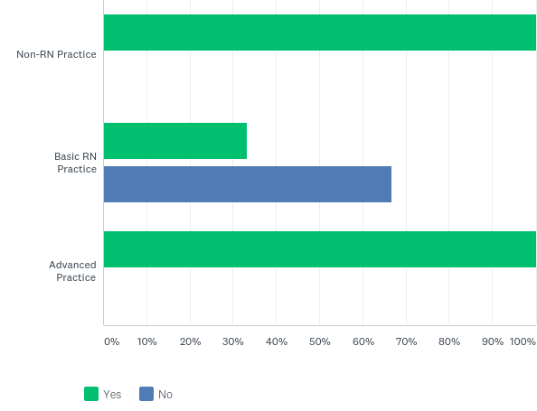
Q10: Is an educational degree an eligibility requirement?
Answered: 17 Skipped: 7

Slide 16
Q10: Is an educational degree an eligibility requirement?
Answered: 17 Skipped: 7

Slide 17
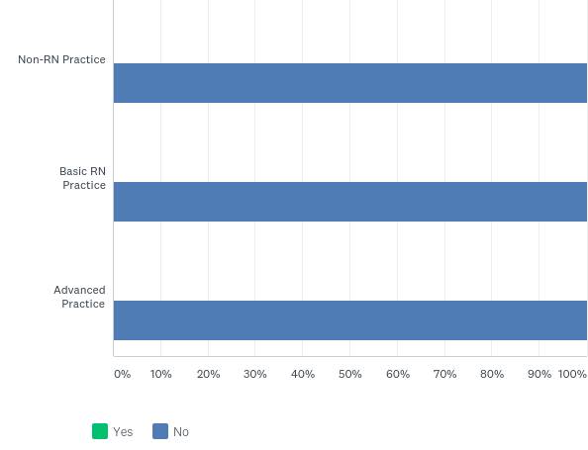
Q11: Are you considering making a BSN a minimum degree requirement for certification eligibility?
Answered: 16 Skipped: 8

Slide 18
Q11: Are you considering making a BSN a minimum degree requirement for certification eligibility?
Answered: 16 Skipped: 8

Slide 19
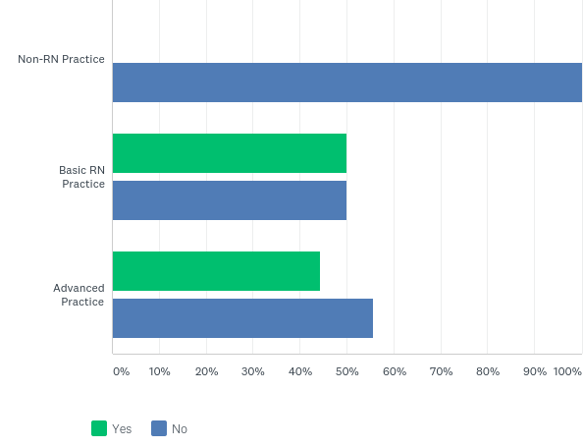
Q12: Do you require the completion of Continuing Education for eligibility?
Answered: 15 Skipped: 9

Slide 20
Q12: Do you require the completion of Continuing Education for eligibility?
Answered: 15 Skipped: 9

Slide 21
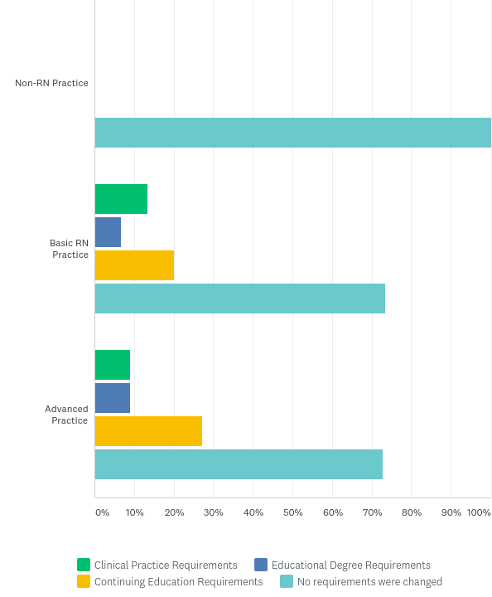
Q14: Have you made any of the following eligibility requirements as part of a formal review, over the past year?
Answered: 17 Skipped: 7

Slide 22
Q14: Have you made any of the following eligibility requirements as part of a formal review, over the past year?
Answered: 17 Skipped: 7

Slide 23
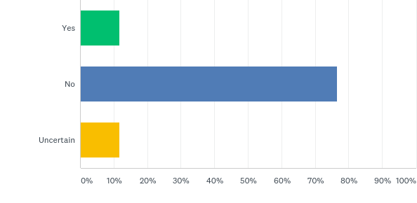
Q16: Do you plan to add any new certification programs in the next 12 months?
Answered: 17 Skipped: 7

Slide 24
Q16: Do you plan to add any new certification programs in the next 12 months?
Answered: 17 Skipped: 7

Slide 25
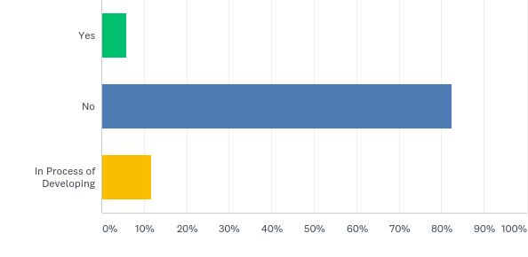
Q18: Do you offer any certificate programs?
Answered: 17 Skipped: 7

Slide 26
Q18: Do you offer any certificate programs?
Answered: 17 Skipped: 7

Slide 27
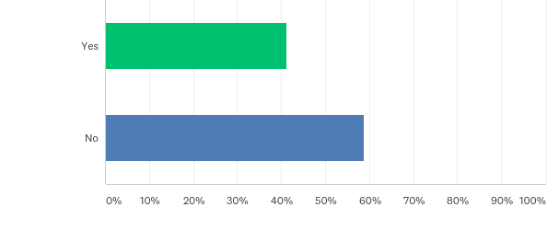
Q20: Do you offer inactive status for credential holders?
Answered: 17 Skipped: 7

Slide 28
Q20: Do you offer inactive status for credential holders?
Answered: 17 Skipped: 7

Slide 29
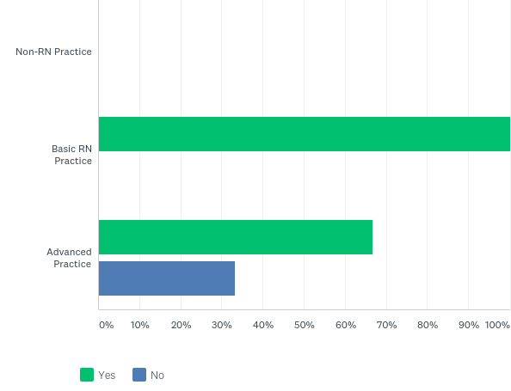
Q21: For which type of certificates do you offer inactive status?
Answered: 7 Skipped: 17

Slide 30
Q21: For which type of certificates do you offer inactive status?
Answered: 7 Skipped: 17

Slide 31
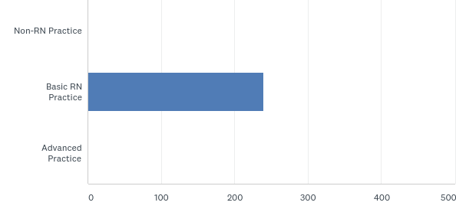
Q23: How many inactive certificants do you currently have?
Answered: 7 Skipped: 17

Slide 32
Q23: How many inactive certificants do you currently have?
Answered: 7 Skipped: 17

Slide 33
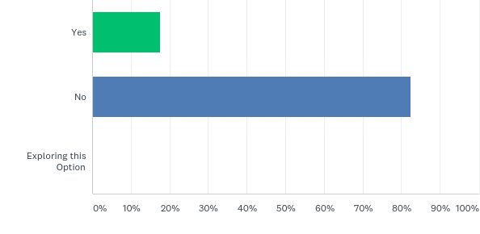
Q24: Do you grant certification credentialing through a portfolio (no exam)?
Answered: 17 Skipped: 7

Slide 34
Q24: Do you grant certification credentialing through a portfolio (no exam)?
Answered: 17 Skipped: 7

Slide 35
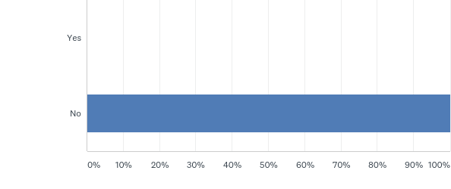
Q25: Are there any age-based requirements for new or recertifying applicants beyond a certain age (e.g. age 70 or over)?
Answered: 17 Skipped: 7

Slide 36
Q25: Are there any age-based requirements for new or recertifying applicants beyond a certain age (e.g. age 70 or over)?
Answered: 17 Skipped: 7

Slide 37
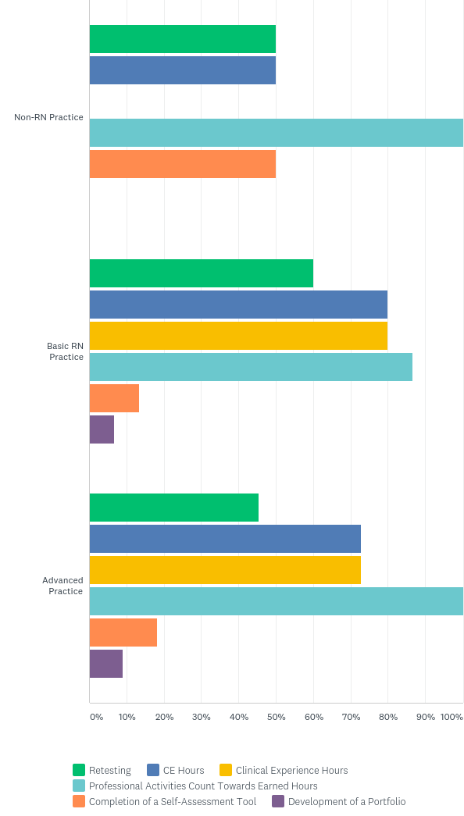
Q26: Please select the requirements for recertification. Select all that apply:
Answered: 17 Skipped: 7

Slide 38
Q26: Please select the requirements for recertification. Select all that apply:
Answered: 17 Skipped: 7

Slide 39
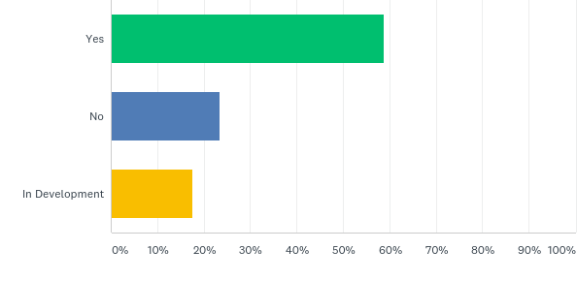
Q28: Do you have an online / web-based program to track recertification requirements?
Answered: 17 Skipped: 7

Slide 40
Q28: Do you have an online / web-based program to track recertification requirements?
Answered: 17 Skipped: 7

Slide 41
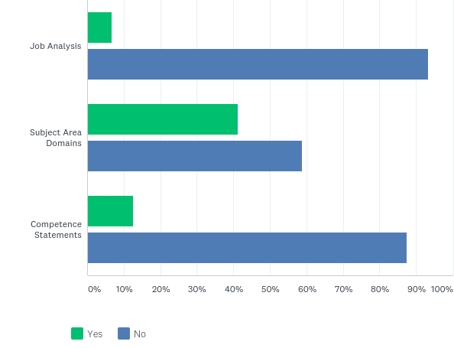
Q29: Do you require certificants to link renewal activities to any of the following? Please select all that apply:
Answered: 17 Skipped: 7

Slide 42
Q29: Do you require certificants to link renewal activities to any of the following? Please select all that apply:
Answered: 17 Skipped: 7

Slide 43
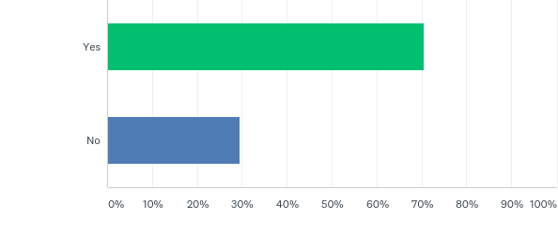
Q30: Does your organization offer practice exams/self-assessments for sale?
Answered: 17 Skipped: 7

Slide 44
Q30: Does your organization offer practice exams/self-assessments for sale?
Answered: 17 Skipped: 7

Slide 45
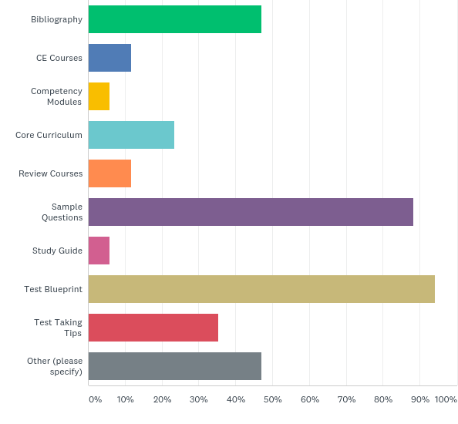
Q31: What study tools do you offer, either free of cost or sold to the exam candidate?
Answered: 17 Skipped: 7

Slide 46
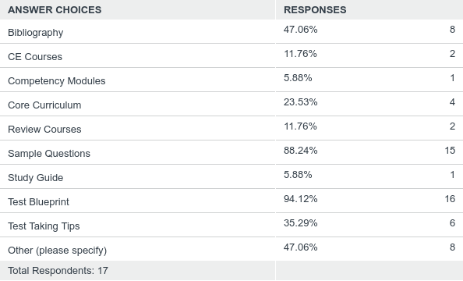
Q31: What study tools do you offer, either free of cost or sold to the exam candidate?
Answered: 17 Skipped: 7

Slide 47
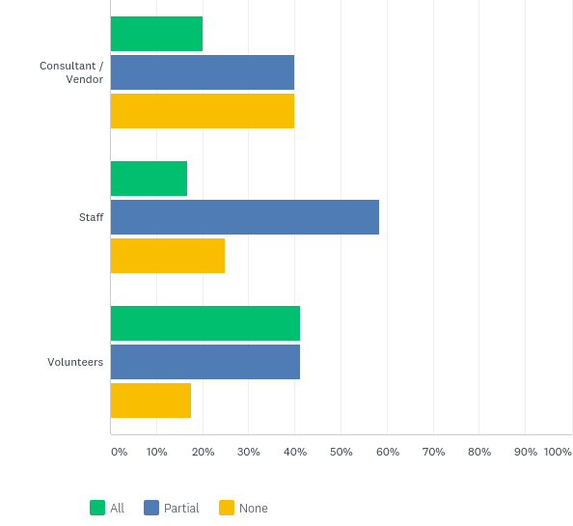
Q32: Who develops your study materials (e.g. CE courses, competency modules, etc.)?
Answered: 17 Skipped: 7

Slide 48
Q32: Who develops your study materials (e.g. CE courses, competency modules, etc.)?
Answered: 17 Skipped: 7

Slide 49
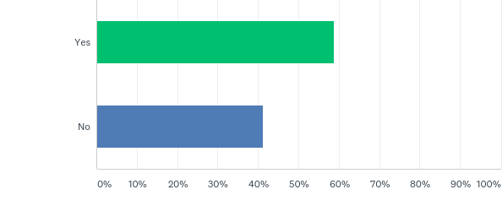
Q33: Does your website include information for test-taking skills and/or test prep?
Answered: 17 Skipped: 7

Slide 50
Q33: Does your website include information for test-taking skills and/or test prep?
Answered: 17 Skipped: 7

Slide 51
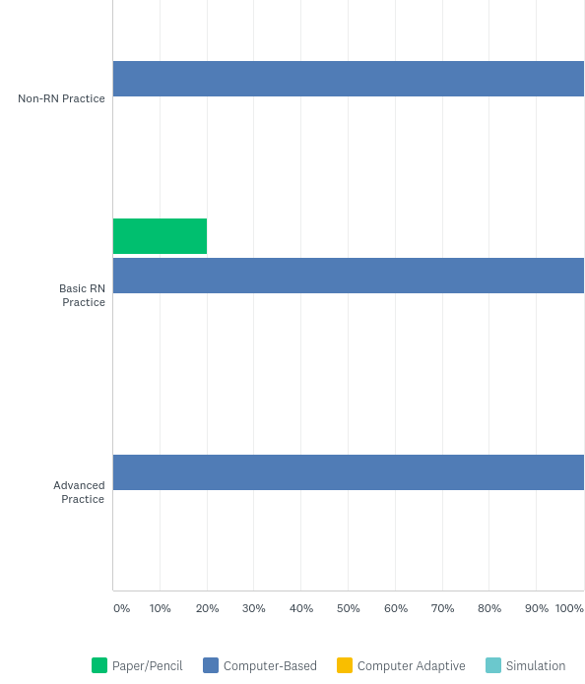
Q35: What method do you use to administer the certification exam? Please select all that apply:
Answered: 17 Skipped: 7

Slide 52
Q35: What method do you use to administer the certification exam? Please select all that apply:
Answered: 17 Skipped: 7

Slide 53
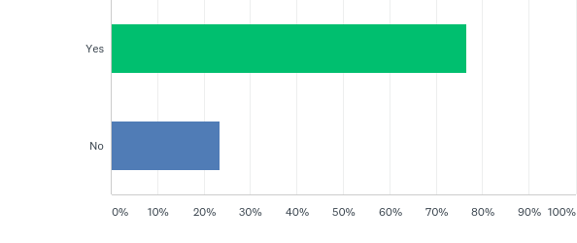
Q37: Do you offer a recertification discount for members of the professional organization?
Answered: 17 Skipped: 7

Slide 54
Q37: Do you offer a recertification discount for members of the professional organization?
Answered: 17 Skipped: 7

Slide 55
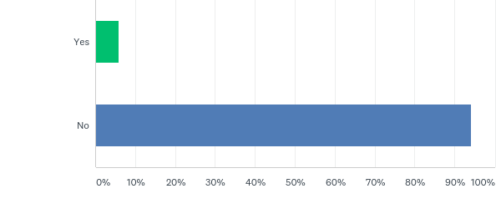
Q38: Did you raise your fee this past year?
Answered: 17 Skipped: 7

Slide 56
Q38: Did you raise your fee this past year?
Answered: 17 Skipped: 7

Slide 57
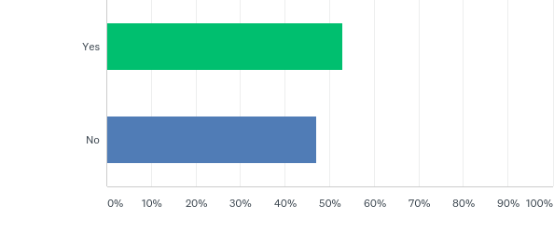
Q40: Do you offer certification exams to nurses not licensed in the U.S. or Canda?
Answered: 17 Skipped: 7

Slide 58
Q40: Do you offer certification exams to nurses not licensed in the U.S. or Canda?
Answered: 17 Skipped: 7

Slide 59
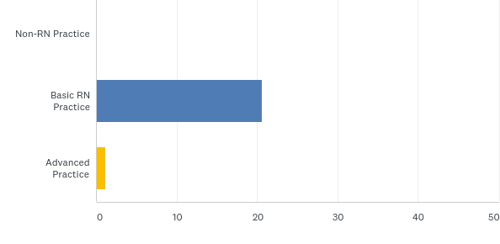
Q41: How many international candidates does your organization have by track?
Answered: 9 Skipped: 15

Slide 60
Q41: How many international candidates does your organization have by track?
Answered: 9 Skipped: 15

Slide 61
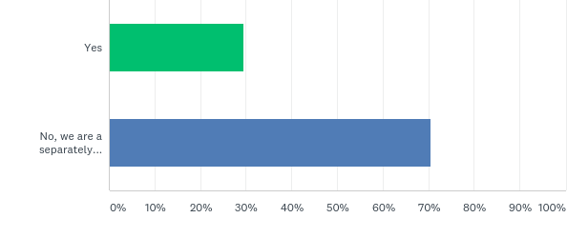
Q44: Is the certification organization part of a professional membership organization?
Answered: 17 Skipped: 7

Slide 62
Q44: Is the certification organization part of a professional membership organization?
Answered: 17 Skipped: 7

Slide 63
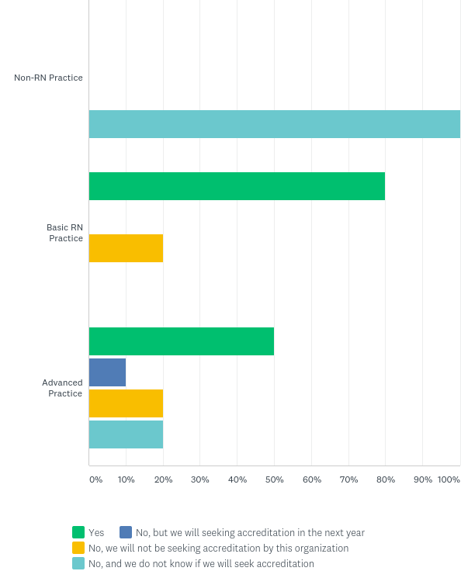
Q45: Are you accredited by the ABSNC?
Answered: 16 Skipped: 8

Slide 64
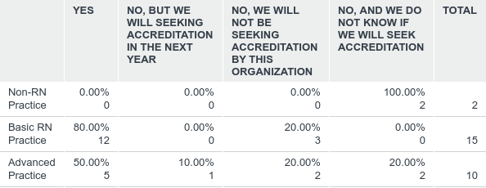
Q45: Are you accredited by the ABSNC?
Answered: 16 Skipped: 8

Slide 65
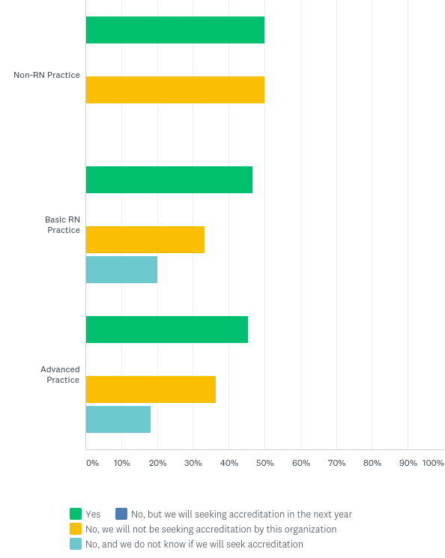
Q46: Are you accredited by the NCCA?
Answered: 17 Skipped: 7

Slide 66
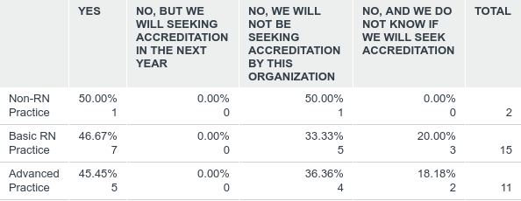
Q46: Are you accredited by the NCCA?
Answered: 17 Skipped: 7

Slide 67
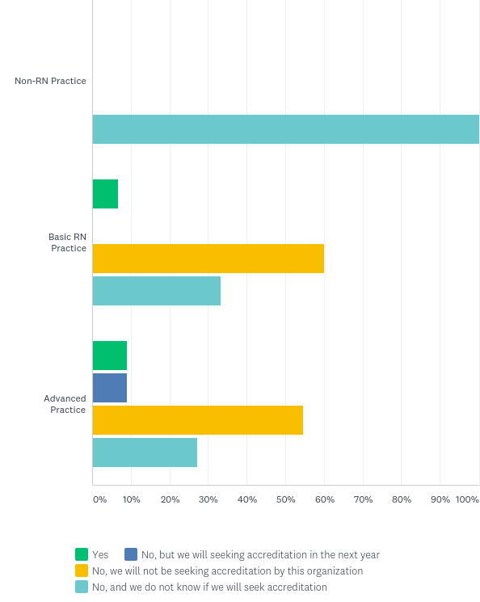
Q47: Are you accredited by the ANSI?
Answered: 17 Skipped: 7

Slide 68
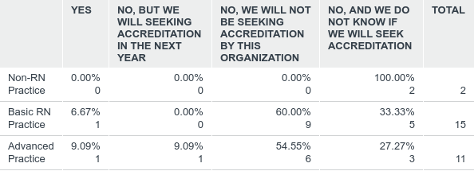
Q47: Are you accredited by the ANSI?
Answered: 17 Skipped: 7

Slide 69
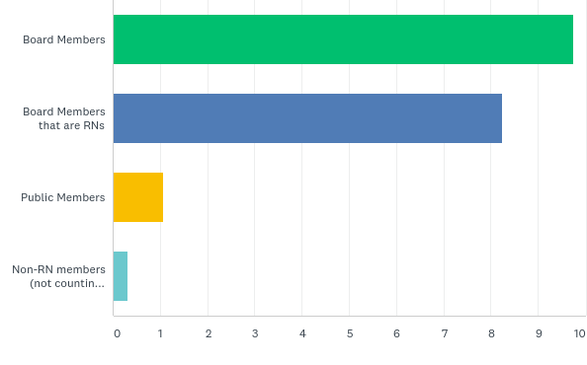
Q48: Please enter how many of the following you have of each on your governing board:
Answered: 17 Skipped: 7

Slide 70
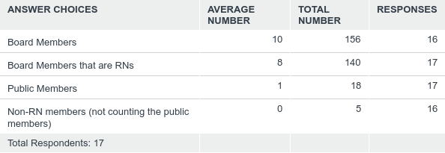
Q48: Please enter how many of the following you have of each on your governing board:
Answered: 17 Skipped: 7

Slide 71
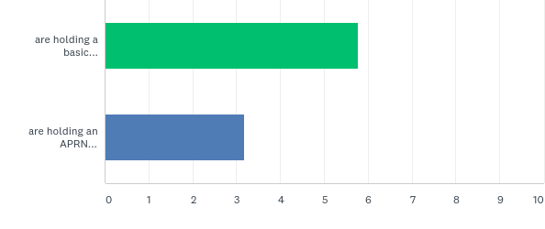
Q49: How many board members...
Answered: 17 Skipped: 7

Slide 72
Q49: How many board members...
Answered: 17 Skipped: 7

Slide 73
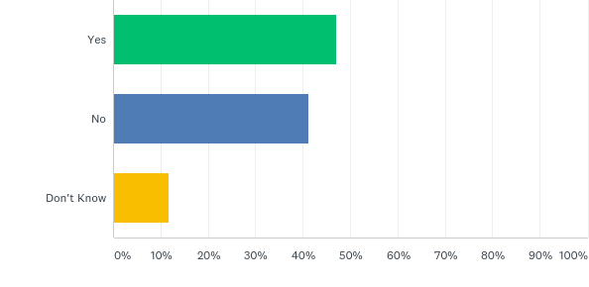
Q52: Is there a formal or written success plan for staff and/or volunteer leadership positions?
Answered: 17 Skipped: 7

Slide 74
Q52: Is there a formal or written success plan for staff and/or volunteer leadership positions?
Answered: 17 Skipped: 7

Slide 75
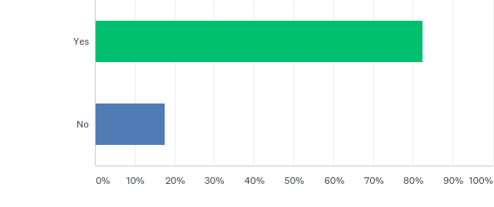
Q53: Are nurse board members required to be certified in the specialty?
Answered: 17 Skipped: 7

Slide 76
Q53: Are nurse board members required to be certified in the specialty?
Answered: 17 Skipped: 7

Slide 77
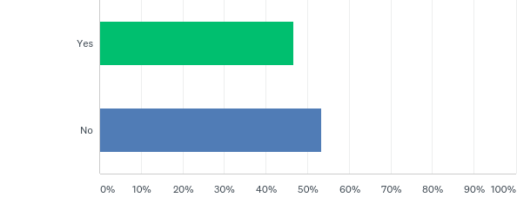
Q54: Are non-RNs eligible to hold officer positions on the board?
Answered: 15 Skipped: 9

Slide 78
Q54: Are non-RNs eligible to hold officer positions on the board?
Answered: 15 Skipped: 9

Slide 79
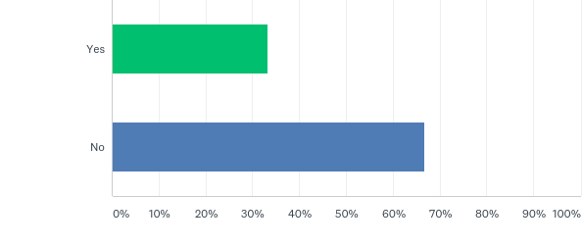
Q55: Does your organization have Board representation (board membership / direct board input) from the membership organization?
Answered: 15 Skipped: 9

Slide 80
Q55: Does your organization have Board representation (board membership / direct board input) from the membership organization?
Answered: 15 Skipped: 9

Slide 81
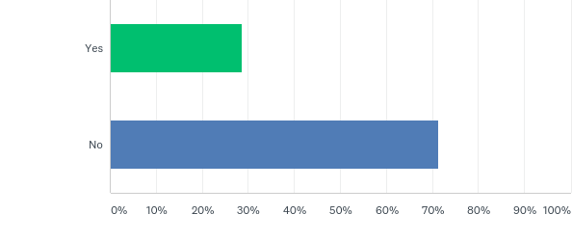
Q56: Can the membership organization board representative vote on Certification Board business?
Answered: 14 Skipped: 10

Slide 82
Q56: Can the membership organization board representative vote on Certification Board business?
Answered: 14 Skipped: 10

Slide 83
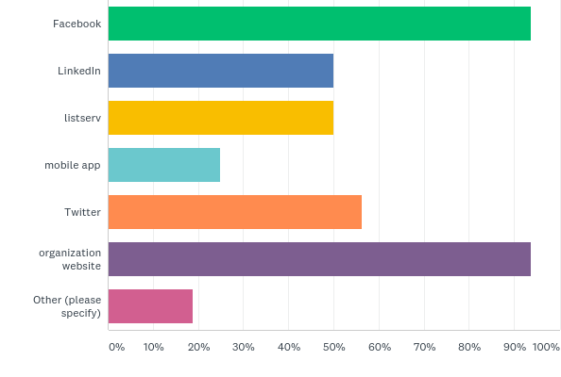
Q59: Do you use any of the following platforms to communicate with your membership?
Answered: 16 Skipped: 8

Slide 84
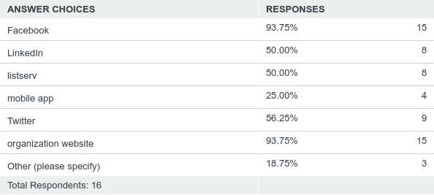
Q59: Do you use any of the following platforms to communicate with your membership?
Answered: 16 Skipped: 8

Slide 85
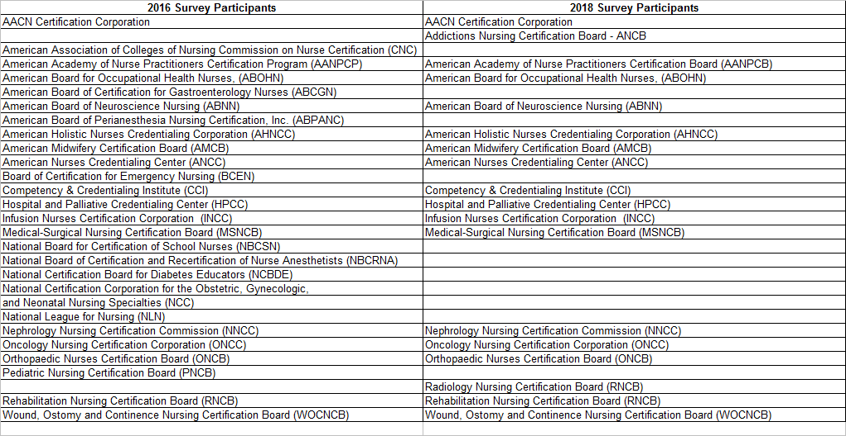
Survey Participants

