Slide 1
Specialty Nursing Board Certifications
February 2020
Notes:
3 objectives
Role of nurses–
Familiarity
Importance and impact of speciality certifications
Questions focus on hospital specifically, rather than wave 1 which was more general receiving health care. Want to remember that our first questions in the survey were to break out demographic groups- looking at those who have visited the hospital in the past 12 months and for what reason.

Slide 2
Abns Polling Presentation
When thinking about choosing a hospital, a strong majority of adults say the quality of nurses is an important factor.
Adults are highly satisfied with the care board certified specialty nurses provide.
Among adults who have received care from a board certified specialty nurse, 83% were very satisfied with the care they received.
An equal percentage of adults say the quality of doctors (92%) and nurses (91%) is important when thinking about choosing a hospital.
Key Points
A hospital having a high percentage of board certified specialty nurses can impact adults’ hospital preference.
Similarly, nearly an equal percentage of adults say doctors and nurses play a significant role in the medical care they receive.
71% of adults would be more likely to recommend a hospital that had a higher percentage of nurses with a specialty board certification.
Receiving care from a board certified specialty nurse has a positive impact on the likelihood to recommend a hospital with a higher percentage of nurses with a specialty board certification.
Adults who have received care from a board certified specialty nurse are more likely to say nurses have a significant impact on the quality of medical care they receive at a hospital.
Adults typically interact with nurses the most at hospitals and have the most influence on how they evaluate their hospital visit.
Nearly a third of adults (30%) would switch to receive medical care at a hospital with a higher percentage of board certified specialty nurses than continuing to receive care at their current hospital.
Over half of adults (55%) say they primarily interacted with nurses at their last visit to a hospital, and are most likely to say nurses impact how they evaluate their experience at a hospital the most(43%).
Methodology
This poll was conducted between February 6-7 among a national sample of 2,200 adults. The interviews were conducted online and the data were weighted to approximate a target sample of adults based on age, educational attainment, gender, race, and region. Results from the full survey have a margin of error of plus or minus 2 percentage points.

Slide 3
Abns Polling Presentation
Contents
The Role of Nurses
Familiarity with Specialty Nursing Board Certifications
Importance and Impact of Specialty Board Certified Nurses In Choosing A Hospital

Slide 4
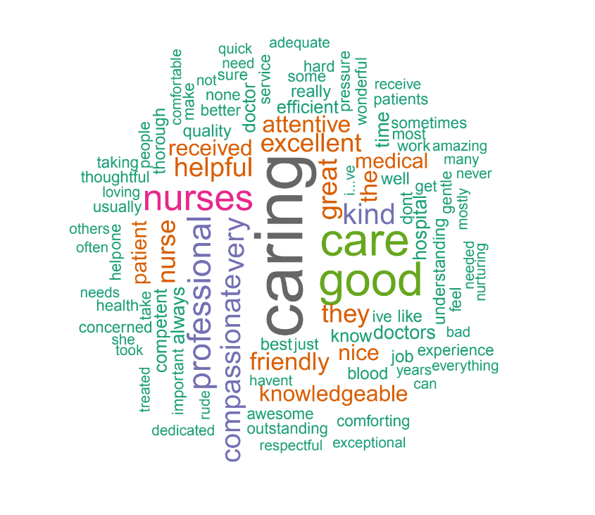
Adults use words like caring, great, professional, compassionate, and helpful to describe the medical care they have received from a nurse.
ABNS6
Abns Polling Presentation
Thinking about nurses, what words or phrases would you use to describe the medical care you have received from a nurse?
Referenced Frequently:
The Role of Nurses
1
Caring/Kind
“The nurses I’ve been in contact with are knowledgeable and caring.”
2
Great/Good
“She was very good. Felt like I was in good hands”
3
Professional
“They are professional and gave me all the support I needed.”
4
Compassionate
“My experience has been very good, they have been compassionate and competent.”
5
Helpful
“Very courteous, informative, helpful with explaining g everything in detail, took great care and had a good bedside manor very friendly and polite.”

Slide 5
When thinking about choosing a hospital, an equal percentage of adults say the quality of doctors (92%) and nurses (91%) are important factors.
ABNS4
Abns Polling Presentation
When thinking about choosing a hospital, how important or unimportant are the following?
Very important
Somewhat
Neither
Somewhat
Very unimportant
Don't know/No
important
important nor
unimportant
opinion
The Role of Nurses
unimportant
Total important
92%
91%
88%
87%
78%
86%
86%
Quality of doctors
82%
10%
Quality of nurses
70%
21%
4%
Reputation
62%
26%
5%
4%
Customer service
61%
26%
7%
4%
In-network provider
60%
18%
11%
6%
Innovative health technology
56%
30%
7%
5%
Location
55%
31%
8%

Slide 6
Over 2 in 3 adults (69%) say nurses had a very significant role in the medical care they received when they visited a hospital.
ABNS6
Abns Polling Presentation
Thinking about when you visit a hospital, how much of a role do each of the following have in the medical care you receive?
A very significant
A somewhat
Don't know/ No
Not a very
No role at all
The Role of Nurses
role
significant role
opinion
significant role
Physicians/Doctors
73%
19%
5%
Nurses
69%
22%
5%
Surgeons
55%
19%
8%
7%
11%
Nurse Practitioners
43%
34%
8%
10%
5%
Physician Assistants
38%
39%
8%
10%
6%
Hospital administrators
25%
28%
10%
25%
12%

Slide 7
Similarly, 3 in 4 adults (74%) say nurses had a significant impact in the quality of care they received when they visited a hospital.
ABNS7
Abns Polling Presentation
Thinking about when you visit a hospital, how much of an impact do nurses have in the quality of medical care you receive?
The Role of Nurses
74%
18%
3%
4%
1%
A significant impact
Somewhat of an
Not much of an
No impact at all
Don't know/No
impact
impact
opinion

Slide 8
Adults who have received care from a board certified specialty nurse are more likely to say nurses have a significant impact on the quality of medical care they receive when they visit a hospital.
ABNS7
Abns Polling Presentation
Thinking about when you visit a hospital, how much of an impact do nurses have in the quality of medical care you receive?
A significant impact
Somewhat of an impact
Not much of an impact
No impact at all
Don't know/No opinion
The Role of Nurses
Adults
74%
18%
4%
Been to hospital in past 12 mos.
79%
17%
Not been to hospital in past 12 mos.
72%
19%
5%
Visited hospital for ER
80%
16%
Had major surgery
86%
13%
Had minor surgery
84%
13%
Treatment from PCP
77%
20%
Treatment from Med Spec
84%
14%
Received care from board certified nurse
85%
12%
Not received care from board certified nurse
60%
30%
4%
5%

Slide 9
Over half of adults (55%) say they primarily interacted with nurses at their last visit to a hospital.
ABNS8
Abns Polling Presentation
Thinking about your last visit to a hospital, of the following, who did you primarily interact with?
Nurses
55%
The Role of Nurses
Physicians/ Doctors
20%
Nurse Practitioners
6%
Physician Assistants
5%
Hospital Administrators
2%
Surgeons
2%
Other, please specify
1%
Don't know/No opinion
9%

Slide 10
Adults who have visited the hospital in the past 12 months to go to the ER or have major surgery are more likely to say they primarily interacted with nurses.
ABNS8
Abns Polling Presentation
Thinking about your last visit to a hospital, of the following, who did you primarily interact with?
The Role of Nurses
Nurses
Physician Assistants
Hospital Administrators
Other, please specify
Physicians/Doctors
Surgeons
Nurse Practitioners
Don't know/No opinion
Adults
55%
20%
5%
6%
9%
Been to hospital in past 12 mos.
54%
23%
5%
9%
Not been to hospital in past 12 mos.
55%
18%
4%
5%
12%
Visited hospital for ER
59%
19%
5%
11%
Had major surgery
57%
13%
4%
16%
8%
Had minor surgery
55%
23%
5%
10%
Treatment from PCP
54%
26%
5%
9%
Treatment from Med Spec
54%
25%
4%
4%
9%
Received care from board certified nurse
51%
27%
5%
5%
11%
Not received care from board certified nurse
45%
30%
7%
9%
4%

Slide 11
Of the medical care providers tested, a plurality of adults (43%) say nurses impact how they evaluate their experience at a hospital the most.
ABNS9
Abns Polling Presentation
Of the following, who impacts how you evaluate your experience at a hospital the most?
Nurses
43%
The Role of Nurses
Physicians/ Doctors
33%
Don't know/No opinion
10%
Nurse Practitioners
3%
Surgeons
3%
Physician Assistants
3%
Other, please specify
2%
Hospital Administrators
2%

Slide 12
Similarly, adults who have visited the hospital in the past 12 months to go to the ER or have major surgery are more likely to say nurses impact how they evaluate their experience at the hospital the most.
ABNS9
Abns Polling Presentation
Of the following, who impacts how you evaluate your experience at a hospital the most?
Nurses
Physician Assistants
Hospital Administrators
Other, please specify
The Role of Nurses
Physicians/Doctors
Surgeons
Nurse Practitioners
Don't know/No opinion
Adults
43%
33%
10%
Been to hospital in past 12 mos.
46%
34%
4%
4%
6%
Not been to hospital in past 12 mos.
42%
32%
13%
Visited hospital for ER
52%
31%
6%
Had major surgery
56%
18%
12%
5%
Had minor surgery
52%
29%
9%
5%
Treatment from PCP
43%
39%
5%
Treatment from Med Spec
48%
32%
7%
5%
Received care from board certified nurse
46%
33%
4%
7%
Not received care from board certified nurse
42%
44%
4%
5%

Slide 13
Abns Polling Presentation
Contents
The Role of Nurses
Familiarity with Specialty Nursing Board Certifications
Importance and Impact of Specialty Board Certified Nurses In Choosing A Hospital

Slide 14
A third of adults who have been to a hospital in the past 12 months say they have received care from a board certified specialty nurse.
ABNS10
Abns Polling Presentation
As you may know, specialty nursing board certifications are additional certifications registered nurses can attain through work experience and further education in their specialty nursing practice area, such as pediatrics, cardiology, and hospice care. To the best of your knowledge, have you ever received care from a board certified specialty nurse?*
Familiarity with Specialty Nursing Board Certifications
55%
31%
14%
Yes
No
Don't know/Unsure
*Among adults who have been to a hospital in the past 12 months to receive treatment, see a medical professional, or undergo a medical procedure, n=755

Slide 15
Adults who have visited the hospital in the past 12 months to have major or minor surgery are most likely to say they have received care from a board certified specialty nurse.
ABNS10
Abns Polling Presentation
As you may know, specialty nursing board certifications are additional certifications registered nurses can attain through work experience and further education in their specialty nursing practice area, such as pediatrics, cardiology, and hospice care.To the best of your knowledge, have you ever received care from a board certified specialty nurse?
Familiarity with Specialty Nursing Board Certifications
Yes
Don't know/Unsure
No
Adults
31%
55%
14%
Been to hospital in past 12 mos.
31%
55%
14%
Visited hospital for ER
33%
53%
14%
Had major surgery
42%
55%
Had minor surgery
39%
54%
8%
Treatment from PCP
35%
51%
14%
Treatment from Med Spec
35%
54%
11%
100%
*Among adults who have been to a hospital in the past 12 months to receive treatment, see a medical professional, or undergo a medical procedure, n=755

Slide 16
Among adults who have received care from a board certified specialty nurse, 83% were very satisfied with the care they received.
ABNS11
Abns Polling Presentation
Thinking specifically about the care you received from a board certified specialty nurse, how satisfied or unsatisfied were you with the care you received?*
Familiarity with Specialty Nursing Board Certifications
*Among adults who have been to a hospital in the past 12 months to receive treatment, see a medical professional, or undergo a medical procedure, and received care from a board certified specialty nurse n=234

Slide 17
Abns Polling Presentation
Contents
The Role of Nurses
Familiarity with Specialty Nursing Board Certifications
Importance and Impact of Specialty Board Certified Nurses In Choosing A Hospital

Slide 18
71% of adults would be more likely to recommend a hospital that had a higher percentage of nurses with a specialty board certification.
ABNS12
Abns Polling Presentation
If you learned that a hospital had a high percentage of nurses with a specialty board certification, would you be more or less likely to recommend that hospital to a family or friend, or would it have no impact either way?
Importance and Impact of Specialty Board Certified Nurses In Choosing A Hospital
40%
31%
27%
1%
2%
Much more likely to
Somewhat more likely
Neither more nor
Somewhat less likely
Much less likely to
recommend
to recommend
less likely to
to recommend
recommend
recommend

Slide 19
Receiving care from a board certified specialty nurse has a positive impact on the likelihood to recommend a hospital with a higher percentage of nurses with a specialty board certification.
ABNS12
Abns Polling Presentation
If you learned that a hospital had a high percentage of nurses with a specialty board certification, would you be more or less likely to recommend that hospital to a family or friend, or would it have no impact either way?
Much more likely to
Somewhat more likely
Neither more nor less
Somewhat less likely
Much less likely to
recommend
to recommend
likely to recommend
to recommend
recommend
Importance and Impact of Specialty Board Certified Nurses In Choosing A Hospital
Adults
40%
31%
27%
Been to hospital in past 12 mos.
45%
27%
26%
Not been to hospital in past 12 mos.
37%
34%
27%
Visited hospital for ER
47%
27%
25%
Had major surgery
53%
25%
20%
Had minor surgery
51%
26%
22%
Treatment from PCP
47%
28%
24%
Treatment from Med Spec
49%
27%
23%
Received care from board certified nurse
59%
25%
15%
Not received care from board certified nurse
43%
25%
28%
4%

Slide 20
68% of adults who have visited a hospital in the past year would be more likely to seek care from a hospital with a high percentage of specialty board certified nurses over the hospital they most recently visited.
ABNS13
Abns Polling Presentation
If you learned that a hospital in your area had a high percentage of specialty board certified nurses, would this make you more or less likely to seek medical care from this hospital instead of the hospital you most recently visited, or would it have no impact either way?*
Importance and Impact of Specialty Board Certified Nurses In Choosing A Hospital
38%
30%
30%
1%
1%
Much more likely to
Somewhat more likely
Neither more nor
Somewhat less likely
Much less likely to
seek
to seek
less likely to seek
to seek
seek
*Among adults who have been to a hospital in the past 12 months to receive treatment, see a medical professional, or undergo a medical procedure, n=755

Slide 21
Over half of adults who have received care from a specialty board certified nurse (53%) say they are much more likely to seek medical care from a hospital with a higher percentage of specialty board certified nurses.
ABNS13
Abns Polling Presentation
If you learned that a hospital in your area had a high percentage of specialty board certified nurses, would this make you more or less likely to seek medical care from this hospital instead of the hospital you most recently visited, or would it have no impact either way?
Much more likely to
Somewhat more likely
Neither more nor less
Somewhat less likely
Much less likely to
seek
to seek
likely to seek
to seek
seek
Importance and Impact of Specialty Board Certified Nurses In Choosing A Hospital
Adults
38%
30%
30%
Been to hospital in past 12 mos.
38%
30%
30%
Visited hospital for ER
40%
31%
27%
Had major surgery
34%
34%
30%
Had minor surgery
40%
31%
27%
Treatment from PCP
39%
30%
30%
Treatment from Med Spec
40%
29%
30%
Received care from board certified nurse
53%
26%
20%
Not received care from board certified nurse
36%
32%
29%
*Among adults who have been to a hospital in the past 12 months to receive treatment, see a medical professional, or undergo a medical procedure, n=755

Slide 22
Nearly a third of adults (30%) would switch to receive medical care at a hospital with a higher percentage of specialty board certified nurses than continuing to receive care at their current hospital.
ABNS14
Abns Polling Presentation
If you learned a comparable hospital in your area had a higher percentage of specialty board certified nurses than your current hospital, would you:
Importance and Impact of Specialty Board Certified Nurses In Choosing A Hospital
40%
30%
31%
Continue to receive medical
Switch to receive medical care
Don't know/No opinion
care at your current hospital
at the hospital with a higher
percentage of specialty board
certified nurses

Slide 23
Adults who have had minor surgery at a hospital in the past 12 months are more likely to say they would switch to receive care at a hospital with a higher percentage of specialty board certified nurses.
ABNS14
Abns Polling Presentation
If you learned a comparable hospital in your area had a higher percentage of specialty board certified nurses than your current hospital, would you:
Continue to receive medical care at
Switch to receive medical care at the
Don't know/No opinion
your current hospital
hospital with a higher percentage of
Importance and Impact of Specialty Board Certified Nurses In Choosing A Hospital
specialty board certified nurses
Adults
40%
30%
31%
Been to hospital in past 12 mos.
46%
29%
25%
Not been to hospital in past 12 mos.
36%
30%
34%
Visited hospital for ER
42%
33%
24%
Had major surgery
52%
28%
20%
Had minor surgery
43%
37%
20%
Treatment from PCP
48%
28%
24%
Treatment from Med Spec
46%
30%
24%
Received care from board certified nurse
52%
35%
14%
Not received care from board certified nurse
54%
23%
23%

