Slide 1
American Board of Nursing Specialties
Member Organization Annual Survey
Presented March 7, 2020

Slide 2
Member Responses

Slide 3
Credentials Offered

Slide 4
Active Certificants by Type
 | 2012 N = 24 | 2013 N = 27 | 2014 N = 28 | 2015 N = 27 | 2016 N = 26 | 2018 N = 18 | 2019 N = 24
Non-RN | 47,319 | 30,610 | 39,420 | 89,018 | 53,361 | 4,299 | 9,147
Basic RN | 350,450 | 421,959 | 471,328 | 446,447 | 474,460 | 363,783 | 526,442
Advanced | 198,804 | 231,115 | 247,164 | 271,056 | 294,457 | 287,058 | 387,021
Total | 596,573 | 683,684 | 757,912 | 806,521 | 822,278 | 655,140 | 922,610
Retired |  |  |  |  |  |  | N= 22
Non-RN |  |  |  |  |  | 2 | 0
Basic RN |  |  |  |  |  | 3,587 | 8,569
Advanced |  |  |  |  |  | 1,349 | 51,886

Slide 5
Our Credentials Have A Wide Age Range *list is a sample
1955 - CRNA
1971 - CNM
1974 – RN-BC
1976 – CCRN
1976 – FNP - BC
1976 - WHNP
1977 – Certified Pediatric Nurse Practitioner – Primary Care
1978 – CNRN
1980 – Certified Emergency Nurse
1984 - Nationally Certified School Nurse
1984 – CRRN
1985 – CRNI
1985 - CGRN
1986 – Oncology Certified Nurse
1988 - ONC
1989 – Certified Addictions RN
1993 – Certified Wound Care Nurse
1994 – Family Nurse Practitioner
2003 – CMSRN
1989 – Certified Addictions RN
1993 – Certified Wound Care Nurse
1994 – Family Nurse Practitioner
1997 – HN-BC
2003 – CMSRN
2004 – Certified Foot Care Nurse
2005 – ACHPN
2005 – Certified Academic Nurse Educator
2013 – NC-BC
2014 – AGCNS
2014 – Bone and Marrow Transplant Nurse
2015 – Wound treatment Associate - Certified
2016 – Trauma Certified Registered Nurse
2016 – ACNPC - AG
2017 – Certificate of Mastery
2019 - NNIC
2020 – Certified Diabetes and Education Specialist; previously Certified Diabetes Educator (1986-2019)

Slide 6
Certification Cycle Length
Non-RN (N = 4) | Basic RN (N = 19) | Advanced (N = 15)
5 years – 2 4 years – 1 3 years – 1 | 5 years – 9 4 years – 5 3 years – 3 1 year – 1 99 years - 1 | 5 years – 9 4 years – 4 3 years – 1 1 year – 1

Slide 7
Direct / Indirect Clinical Experience Required

Slide 8
Educational Degree Eligibility Requirement
Considering BSN Minimum Degree Requirement for Eligibility

Slide 9
CE Required for Exam Eligibility

Slide 10
Changes to Eligibility Requirements Past 12 months

Slide 11
Exam Retake Limits (N = 24)
None – 13
1x per 6 months - 1
3x in 12 months. Must wait 60 days between - 1
3x in 12 months - 2
2x per 12 months - 1
2x per 12 months – 90 day waiting period between - 1
4x per 12 months - 1

Slide 12
Contact Hours Required Per Recertification Cycle
Non-RN – None
Basic RN – 0-100 Hours
Advanced – 0-100 Hours

Slide 13
Requirement Options Accepted for Recertification

Slide 14
Online or Web-based Program to Track Recertification Requirements

Slide 15
Certificants are Required to Link Renewal Activities

Slide 16
Recertification Rate
Average of respondents 2019 data
Practice | N | Avg. Recert Rate | High | Low
Non-RN | 3 | 83.5% | 90% | 80%
Basic RN | 19 | 79.17% | 92% | 40%
Advanced | 14 | 58.33% | 94% | 54%

Slide 17
Fast Facts from Survey Respondents
23/24 do a role delineation study every 5 years
2/24 plan to add a new certification program in the next 12 months
7/24 offer, or are planning to offer, a certificate program
6/24 offer inactive status for RN credential holders
3/24 offer certification credentialing through a portfolio (no exam)

Slide 18
Practice Exams are Offered for Sale

Slide 19
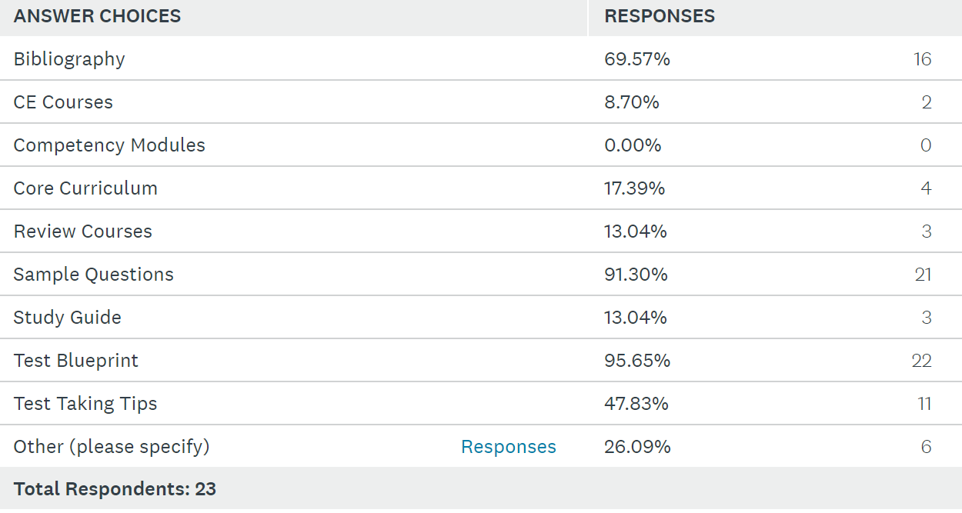
Study Tools are Offered at no cost or sold to the exam candidate

Slide 20
Who Develops Study Materials?

Slide 21
Website is Inclusive of Information for Test Taking Skills and/or Test Prep

Slide 22
Pass Rate for First-Time Exam Takers Average across all programs per organization
Practice | N | Average | High | Low
Non-RN | 4 | 82% | 90% | 73%
Basic RN | 19 | 74% | 90% | 57%
Advanced | 15 | 78% | 90% | 56%
Exam Delivery Modes

Slide 23
Exam Fees and Member Discounts
INITIAL EXAM
9/20 offer a membership discount
Fees for members
$180 - $400
Fees for Non-members
$300 - $995
RECERTIFICATION
16/23 offer a membership discount
Fees for members
$100 - $396
Fee for non-members
$200 - $516
6/18 raised exam prices this past year

Slide 24
When is Testing Offered
Non-RN (N = 4)
122, 260, 300, 360 (in days per year)
Basic RN (N = 18)
Year around = (6)
Mon – Sat = (1)
57, 60, 83, 93, 122, 300 (in days per year)
Advanced (N = 15)
Year around = (7)
Mon – Sat = (1)
60, 122, 260, 300, 308 (in days per year)

Slide 25
International Data
12/24 offer exams to nurses not licensed in the US
Average Pass Rates
Average Recertification Rates

Slide 26
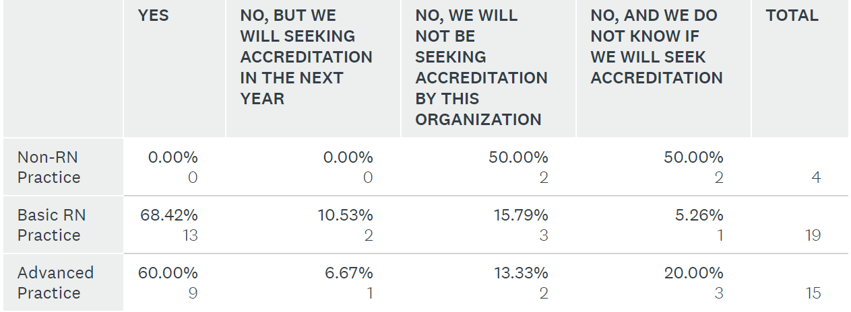
ABSNC Accreditation

Slide 27
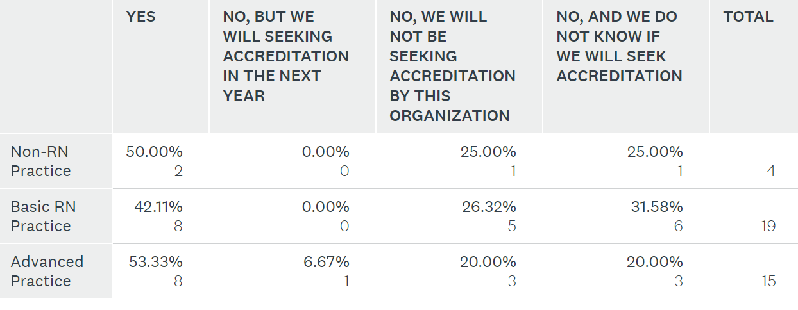
NCCA Accreditation

Slide 28
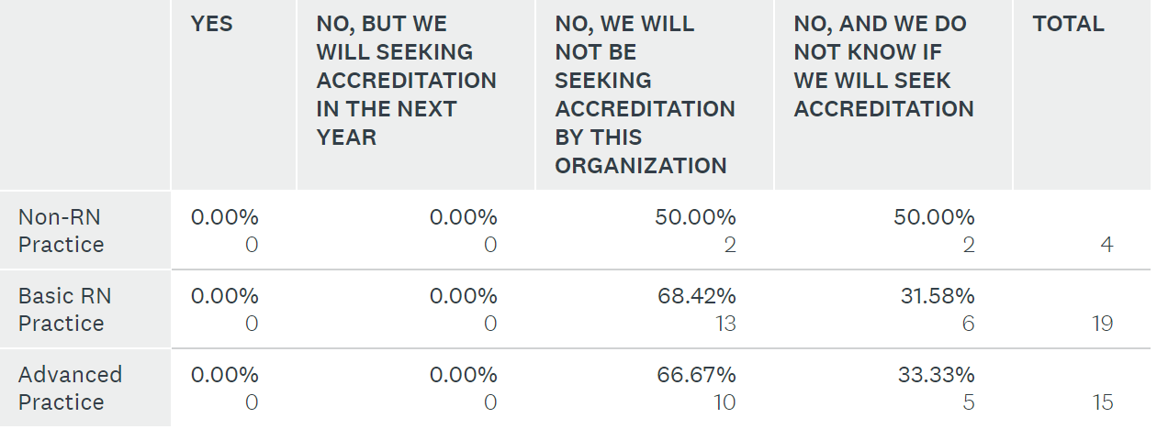
ANSI Accreditation

Slide 29
Organizational Structure / Board Composition
17/24 are completely separate from a membership organization
11/23 have a written formal succession plan

Slide 30
Board Composition
18/23 require Specialty Certification for Nurse Board Members
12/23 allow non RNs to hold officer positions

Slide 31
Board Composition
9/23 have board representation from the membership organization
3/23 allow membership organization board members to vote on certification organization business

Slide 32
Board Composition
Board Terms in Years (N = 23)
3 year terms - 16
4 year terms - 3
2 year terms - 2
5 year term - 1
6 year term - 1
Consecutive Terms (N = 23)
6 consecutive terms - 16
unlimited - 2
2 consecutive terms - 2
0 consecutive terms - 1
8 consecutive terms - 1
5 consecutive terms - 1

Slide 33
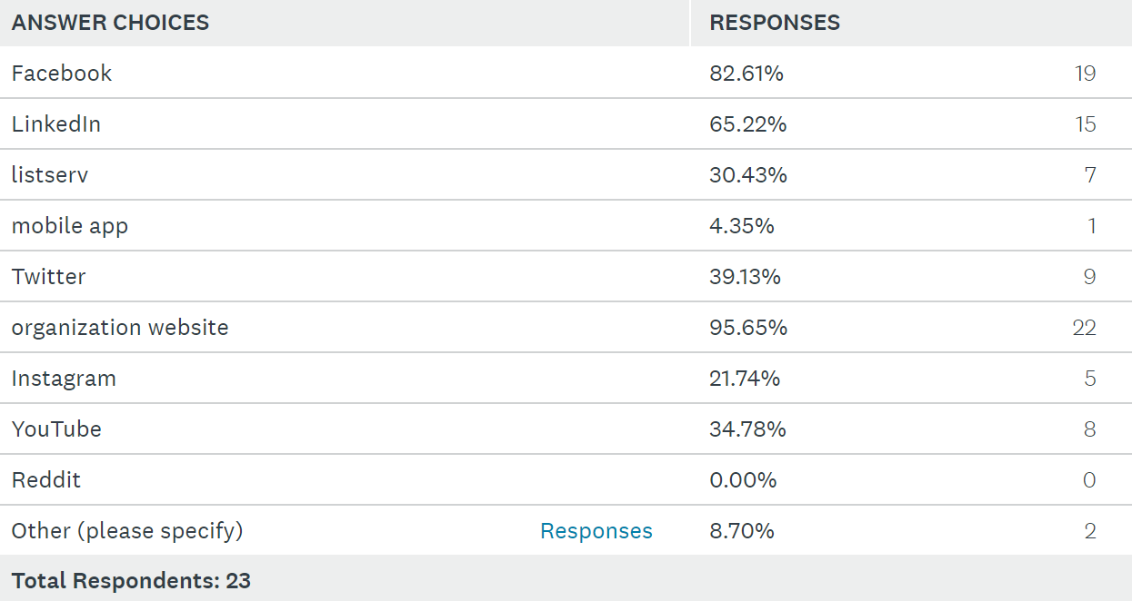
Communication Vehicles

Slide 34
Trends From Past Year
Increased interest in certification and applicants
Increased recertification rates
Higher pass rates
Increased concern for exam security / integrity
LOFT testing
Decline in recertification rates
Increased interest internationally
Increased employer support
Nurses changing specialties
LPN certification interest
Increased interest in review materials
Difficulty recruiting volunteers
Increase in accommodation and appeal requests
Increased interest in sub-specialty certifications

